Slide 1

ENERGY STAR DATASET
PRESENTED BY: GROUP 2
April 27, 2024
ADTA 5240 – HARVESTING, STORING AND RETRIEVING DATA

Slide 2
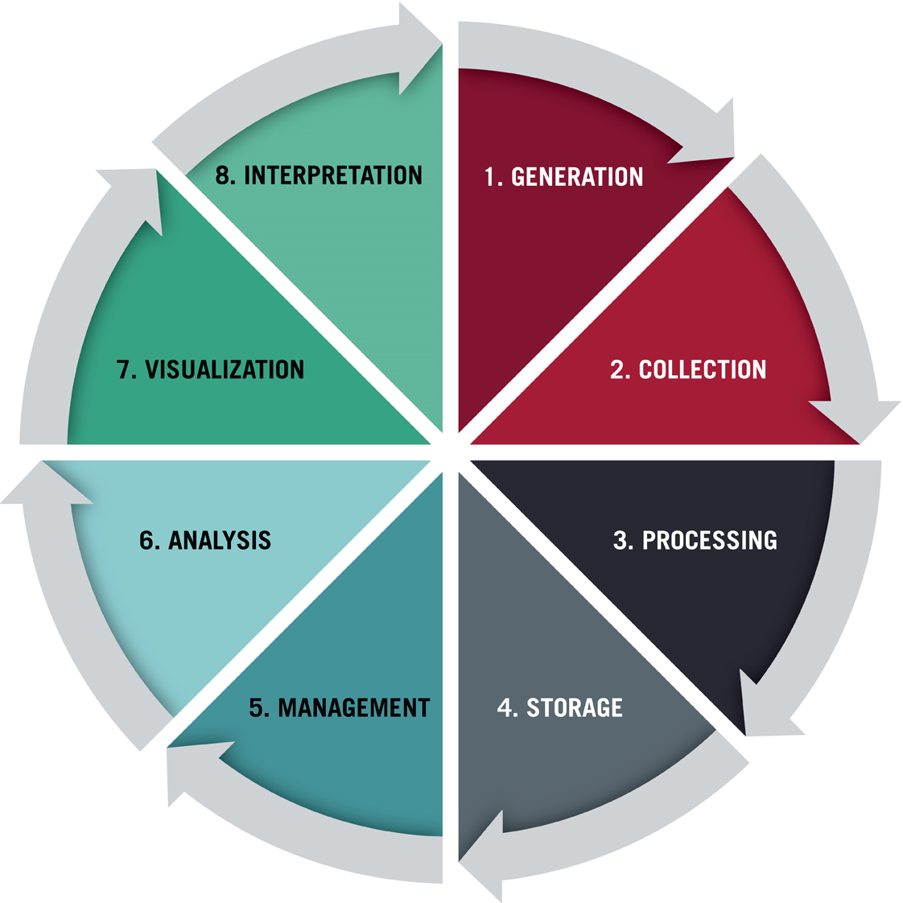
Data Analytics Lifecycle

Slide 3



Data Generation and Collection

Slide 4
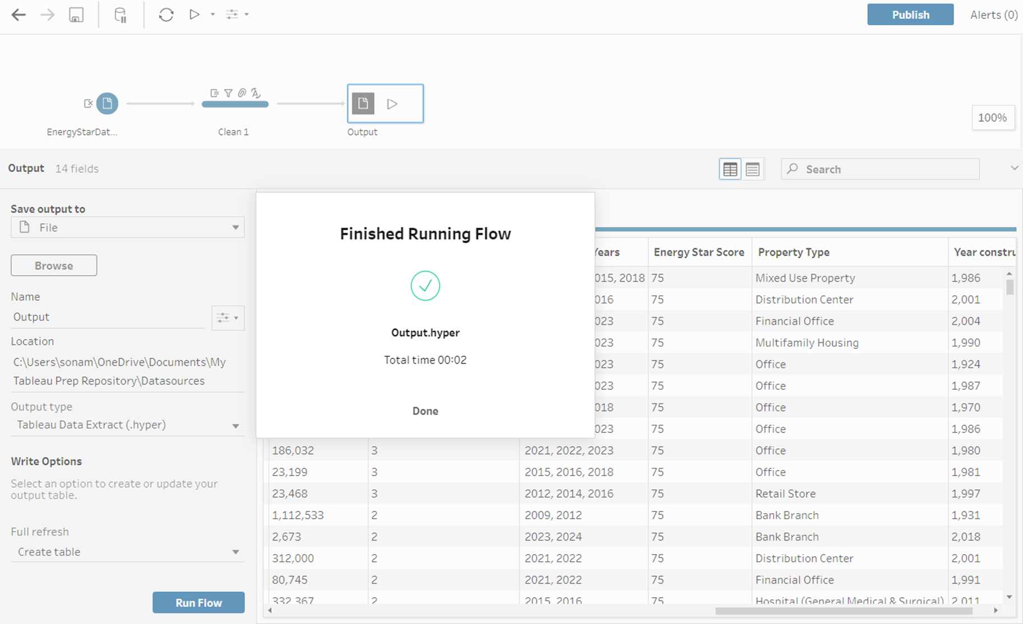
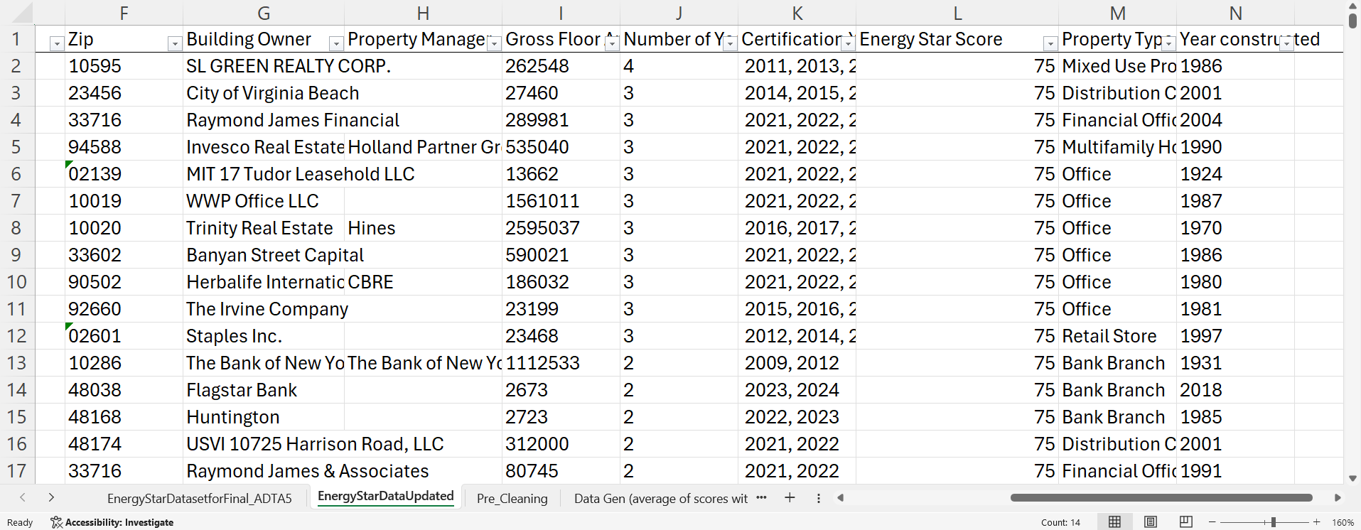
Data Processing
Use of Tableau Prep Builder and Excel to clean data

Slide 5

Data Storage
GCP STORAGE
STRUCTURED DATA
BIG QUERY

Slide 6
How we analyzed our data
Building owner
State
City
Type of Property
Property Managers

Slide 7

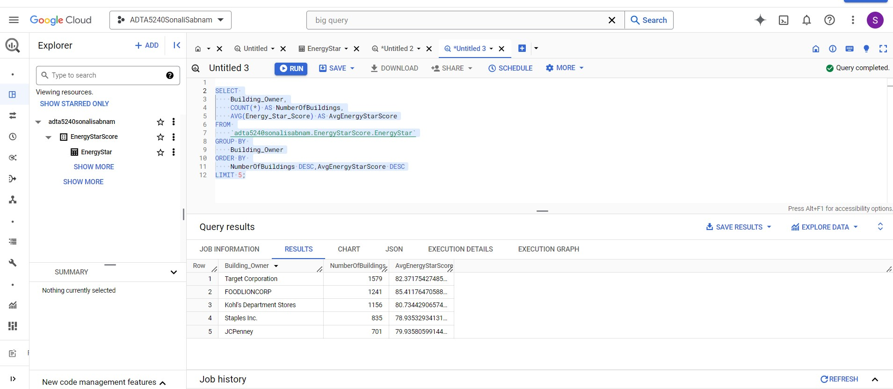
BIGQUERY ANALYSIS : 1.Top 5 Energy-Conscious Building Owners

Slide 8
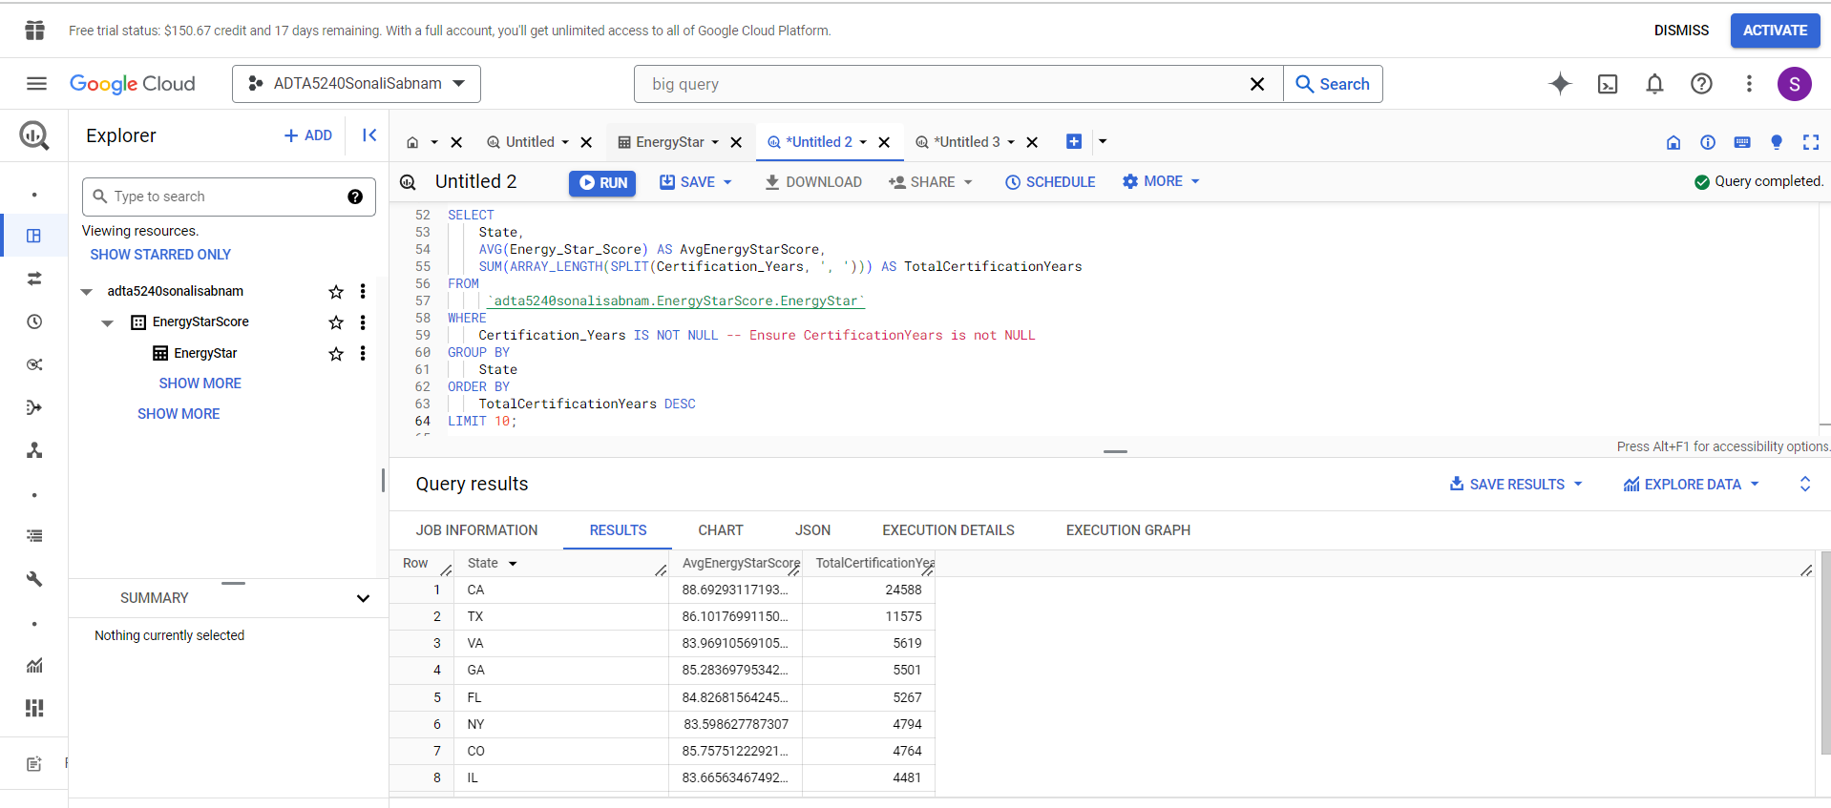
2. State-by-State Energy Performance Comparison

Slide 9
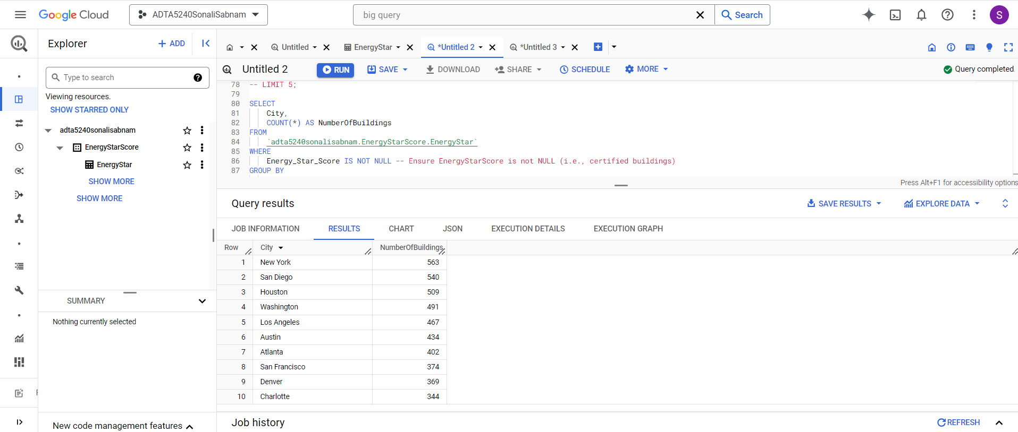
3. Top Cities with Energy Star-Certified Buildings: Key to Sustainable Business Expansion

Slide 10
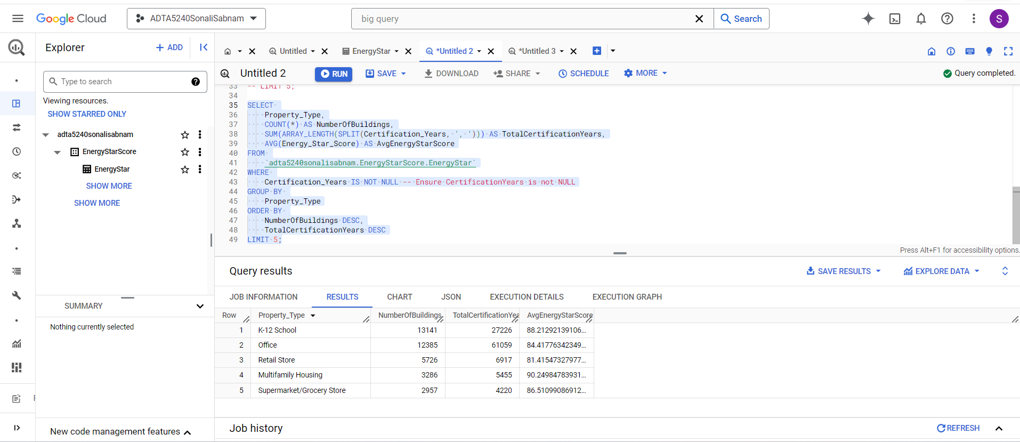
4. Analyzing Property Types with Energy Star Certification: A Focus on Retail

Slide 11
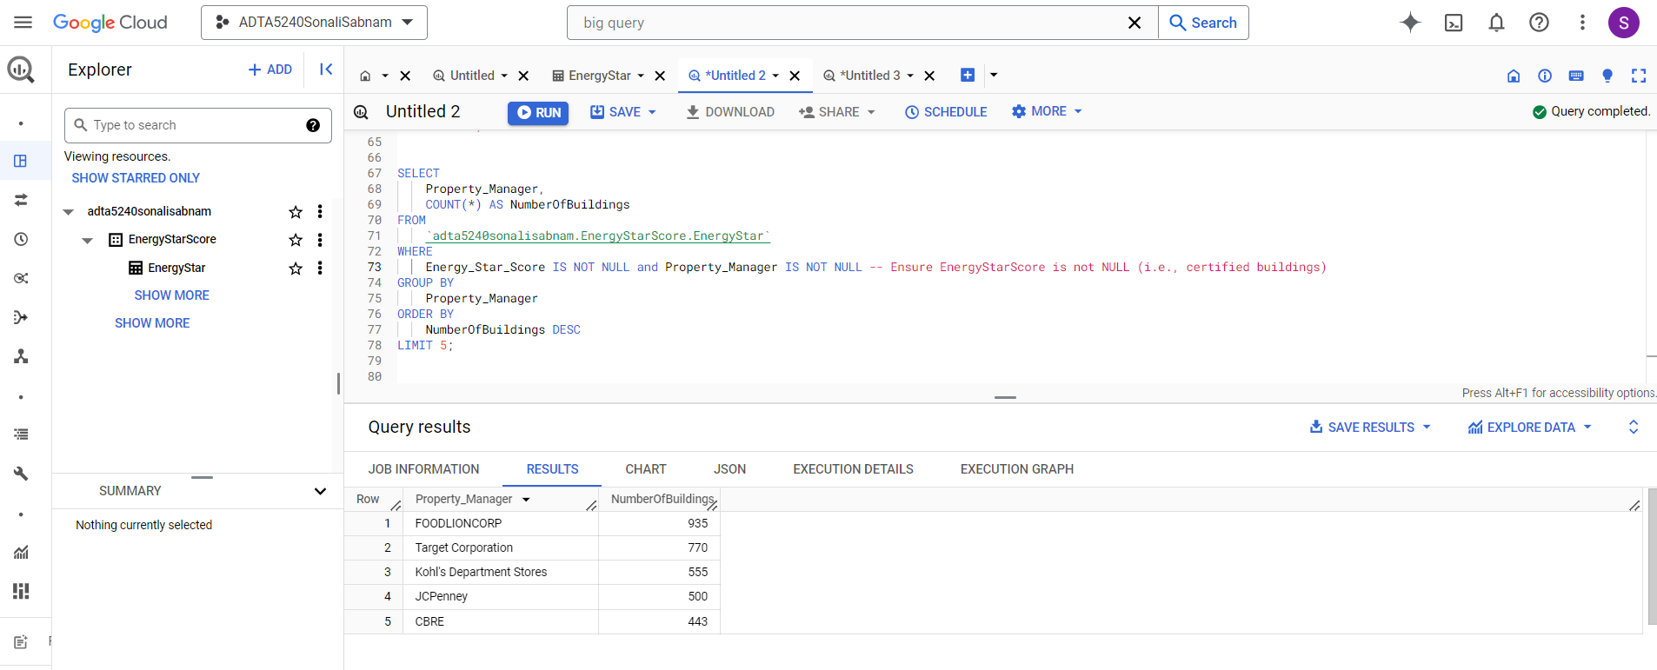
5. Correlation of Energy Efficiency and Property Management in Retail

Slide 12
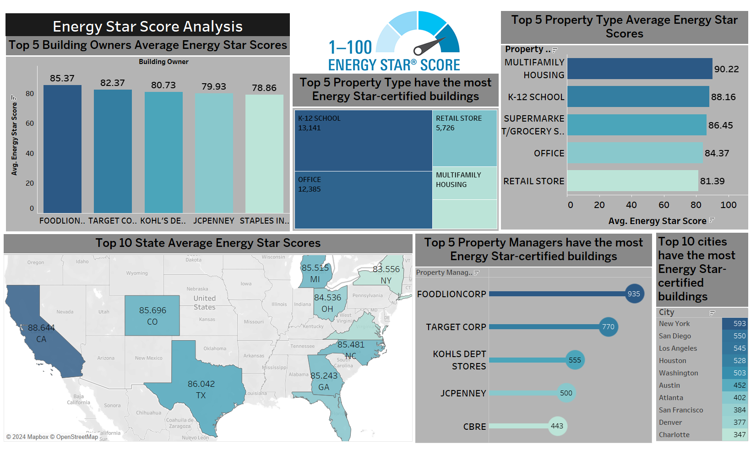
Visualizations

Slide 13
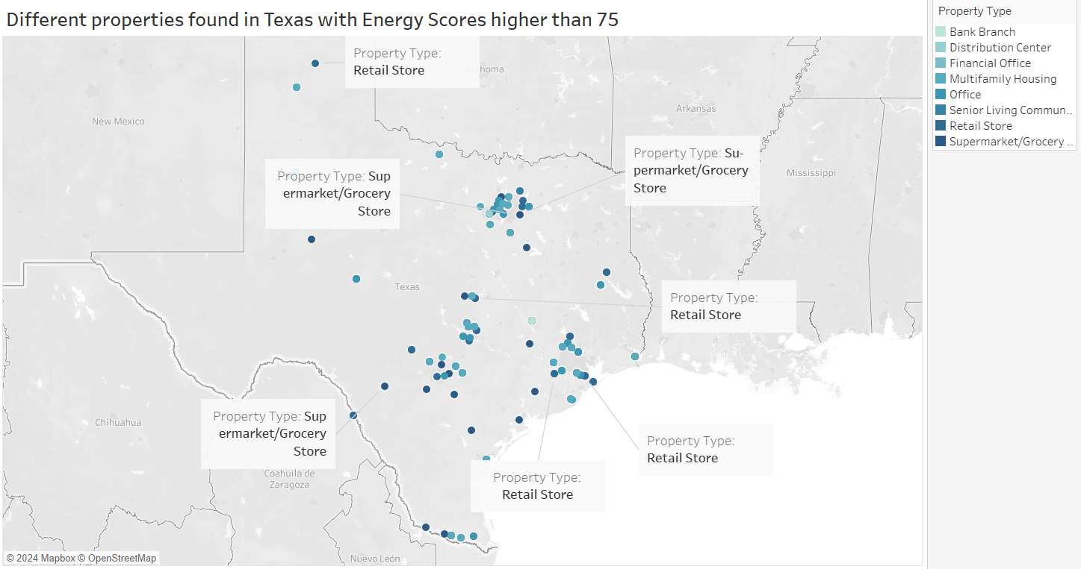
Recommendations
Everything’s bigger in Texas, and so will your success be!

Slide 14



The team!
Hemalatha Kamesh –ADTA
Visualization and Data Cleaning
Sonali Sabnam – ADTA
Data Storage and Processing
Sonam Pohuja - ADTA
Data Cleaning and Interpretation

